Slide 1
FCS (Recurrences)
DR. ADEEL HASHMI
ASSt. Prof., cse dept.
msit

Slide 2
Recurrence Relation
A recurrence relation is a series of terms where the current term depends on previous terms.
Example is fibonacci series, where the current term is the sum of previous two terms (0,1,1,2,3,5,8,13,…) i.e. T(n) = T(n-1) + T(n-2)

Slide 3
Form
A recurrence relation of order “k” is of the form:
C_{n}T_{n} = C_{n-1}T_{n-1} + C_{n-2}T_{n-2} …+ C_{n-k}T_{n-k} + F(n)
If F(n)=0, its is called homogeneous RR.
Otherwise it is called non-homogeneous RR.

Slide 4
Solving RR
Sometimes, we may be interested in finding the value of a particular term (say 100th term) in the sequence, and generating the whole sequence till the desired term may become a tedious task.
Hence, we would like to have a general solution for recurrence relation, by which we can generate the desired term easily.

Slide 5
Steps
Convert RR into “characteristic equation” by replacing lowest term i.e. T(n-k) with 1, next higher term with x, next higher term with x², and so on.
Solve characteristic equation to find the roots r₁, r₂, …
The solution of a homogeneous recurrence relation is of the form:
T_{n} = α₁(r₁)^{n} + α₂(r₂)^{n} + … α_{k}(r_{k})^{n}

Slide 6
Example-1
Example
Find a solution for the recurrence relation, T_{n} = T_{n-1} + 2T_{n-2} with T₀=2, T₁=7.
Answer.
For the given recurrence relation, characteristic equation will be
x² = x + 2
Solving this characteristic equation, we get r₁=2 and r₂=-1.
So, the solution will be of the form
T_{n} = α₁(2)^{n} + α₂(-1)^{n}
Therefore,
T₀ = α₁(2)⁰ + α₂(-1)⁰ ⇒ 2 = α₁ + α₂
T₁ = α₁(2)¹ + α₂(-1)¹ ⇒ 7 = 2α₁ − α₂
Solving the two equations, we get α₁=3 and α₂=-1.
Hence, the solution for the given recurrence relation is, T_{n} = 3(2)^{n} − (-1)^{n}.

Slide 7
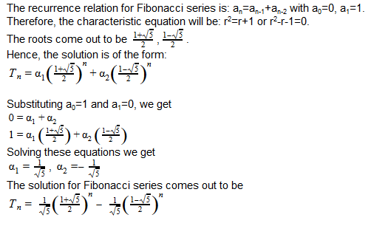
Example-2
Example
Find the general solution for Fibonacci series.
Answer.

Slide 8
HRR with repeated roots
If the solution of the characteristic equation gives repeated roots, then the solution of the recurrence relation is of the form:
(α₀ + α₁n + α₂n² + … + α_{m-1}n^{m-1})r^{n}
for each root “r” with multiplicity “m”.
If the roots are 5,5,5
The solution will be of the form
(α₀ + α₁n+ α₂n²)5^{n}

Slide 9
Example
For example, suppose that the roots of the characteristic equation of the recurrence relation are 2, 2, 2, 5, 5 and 9 i.e. 2 with multiplicity three, 5 with multiplicity two, and 9 with multiplicity one. Then, the general form of the solution will be
(α_{1,0} + α_{1,1}n + α_{1,2}n²)2^{n} + (α_{2,0} + α_{2,1}n)5^{n} + α_{3,0}9^{n}

Slide 10
Question
Example
Find the solution for the recurrence relation
T_{n} = -3T_{n-1} – 3T_{n-2} – T_{n-3} with initial conditions T₀=1, T₁=-2 and T₂=-1.
Answer.
The characteristic equation of this recurrence relation is
r³ + 3r² + 3r + 1 = 0
The roots for this equation come out to be -1, -1, -1 i.e. a single root -1 with multiplicity 3.
Hence the solution will be of the form
T_{n} = (α_{1,0} + α_{1,1}n + α_{1,2}n²)(-1)^{n}
As T₀=1, therefore we get α_{1,0}=1
As T₁=-2, therefore we get (α_{1,0} + α_{1,1} + α_{1,2})(-1) = -2
As T₂=-1, therefore we get (α_{1,0} + 2α_{1,1} + 4α_{1,2}) = -1
Solving the above equations, we get α_{1,0} = 1, α_{1,1} = 3, α_{1,2} = -2.
Hence, solution for the given recurrence relation is
T_{n} = (1 + 3n – 2n²)(-1)^{n}

Slide 11
Non-homogeneous RR
A non-homogeneous recurrence relation is of the form:
t_{n} = c₁t_{n-1} + c₂t_{n-2} + … + c_{k}t_{n-k} + F(n)
where,
F(n)=(b₀+b₁n+...+b_{k}n^{k})s^{n}

Slide 12

Solution of NHRR

Slide 13
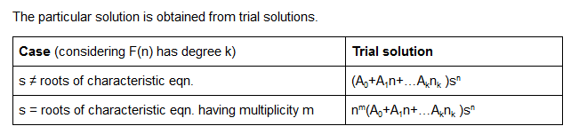
Particular solution

Slide 14
Example
Example
What form does a particular solution of t_{n}=6t_{n-1}-9t_{n-2}+F(n) have when
F(n)=3^{n} F(n)=n3^{n} F(n)=(n²+1)3^{n} F(n)=n²2^{n}
Answer.
The roots of associated homogeneous recurrence relation i.e. t_{n}-6t_{n-1}+9t_{n-2}=0
=> (r²–6r+9=0) are 3,3 i.e. r=3 with m=2.
F(n)=3^{n} i.e. (b₀)s^{n} where b₀=1 and s=3.
s=3, and we know r=3, hence s=r, r has multiplicity 2. So, the trial solution is n²A₀3^{n}.
F(n)=n3^{n} i.e. (b₀+b₁n)s^{n} where b₀=0, b₁=1 and s=3.
s=3, and we know r=3, hence s=r, r has multiplicity 2. So, the trial soln. will be n²(A₀+A₁n)3^{n}.
F(n)=(n²+1)3^{n} i.e. (b₀+b₁n+b₂n²)s^{n} where b₀=1, b₁=0, b₂=1 and s=3.
s=3, and we know r=3, hence s=r, r has multiplicity 2. So, the trial soln. will be n²(A₀+A₁n+A₂n²)3^{n}.
F(n)=n²2^{n} i.e. (b₀+b₁n+b₂n²)s^{n} where b₀=0, b₁=0, b₂=1 and s=2.
As, here s=2, and we know r=3, so s≠r. The trial soln. is (A₀+A₁n+A₂n²)2^{n}.

Slide 15
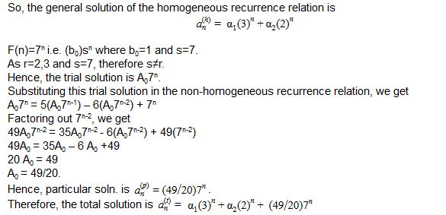
Question
Example
Find the solution of the recurrence relation, t_{n}=5t_{n-1}-6t_{n-2}+7^{n}.
Answer.
The characteristic eqn. for the associated homogeneous recurrence is r²-5r+6=0
The roots of this eqn. are 3 and 2.

Slide 16
Exercise
Find the solution of the recurrence relation
t_{n} = 7t_{n-2} + 6t_{n-3} t₀=9, t₁=10, t₂=32.
What will be trial solutions for t_{n} = 8t_{n-2} – 16t_{n-4} + F(n)
F(n) = n³
F(n) = (-2)^{n}
F(n) = n2^{n}
F(n) = n²4^{n}
F(n) = (n²-2)(-2)^{n}
F(n) = n⁴2^{n}
F(n)=2
Find the solution of the recurrence relation
t_{n} = 5t_{n-1} – 6t_{n-2} + 2^{n} + 3n

